Slide 1




Slide 2


Slide 3
Team Member Details :
Team Name:
The InnoVisionaries
Team Leader Name: Malya Manohar
Branch (Btech) Stream (ECE) Year (II)
Team Member 1 Name: Vartika Shikha
Branch (Btech) Stream (ECE) Year (II)
Team Member 2 Name: Avinash Goyal
Branch (Btech) Stream (ECE) Year (II)
Team Member 3 Name: Subham Kumar
Branch (Btech) Stream (ECE) Year (II)
Team Member 4 Name: Anurag Kashyap
Branch (Btech) Stream (ECE) Year (II)
Team Member 5 Name: Aditya Kumar
Branch (Btech) Stream (ECE) Year (II)
Team Mentor 1 Name: Sinjan Kumar
Category (PhD) Expertise (Virtual Reality (VR))
Team Mentor 2 Name: Type Your Name Here
Category (Academic/Industry): Expertise (AI/ML/Blockchain etc): ):

Slide 4


Slide 5


Slide 6


Slide 7
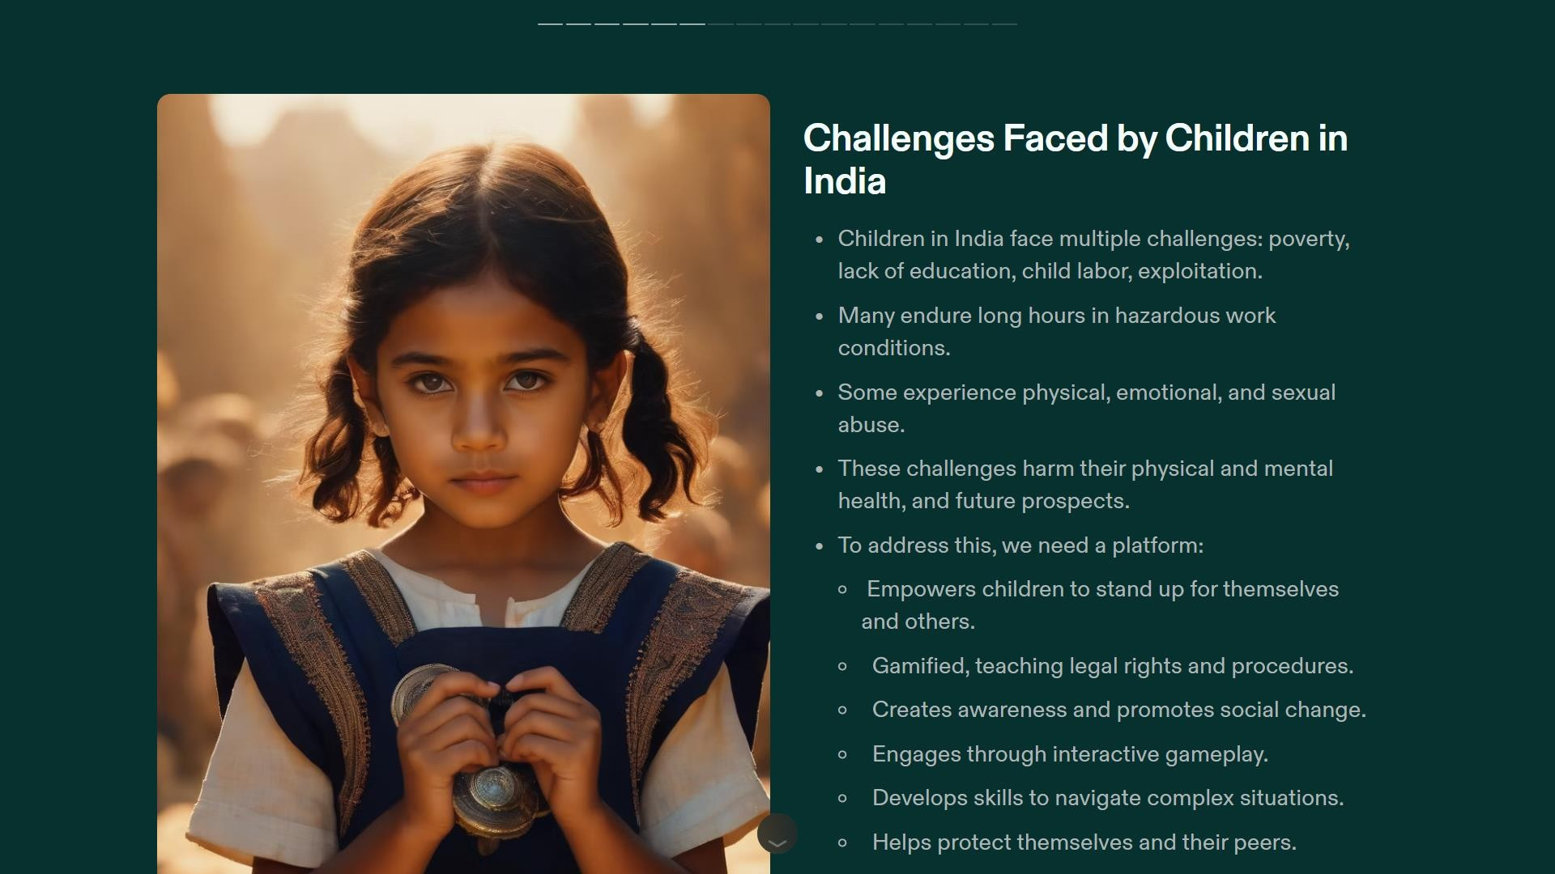

Slide 8


Slide 9
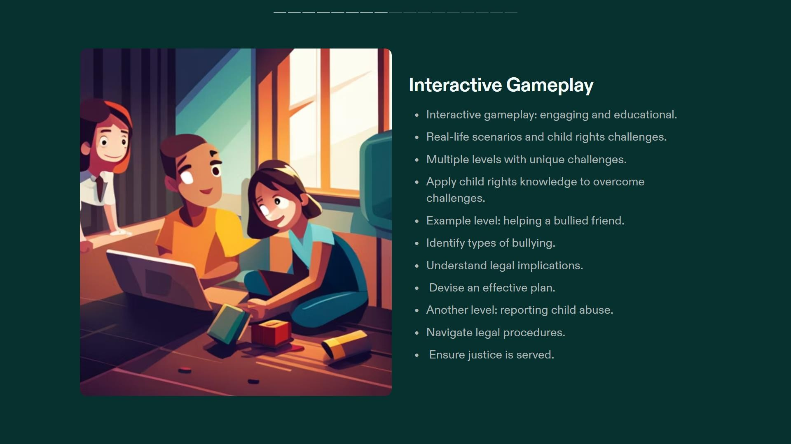

Slide 10
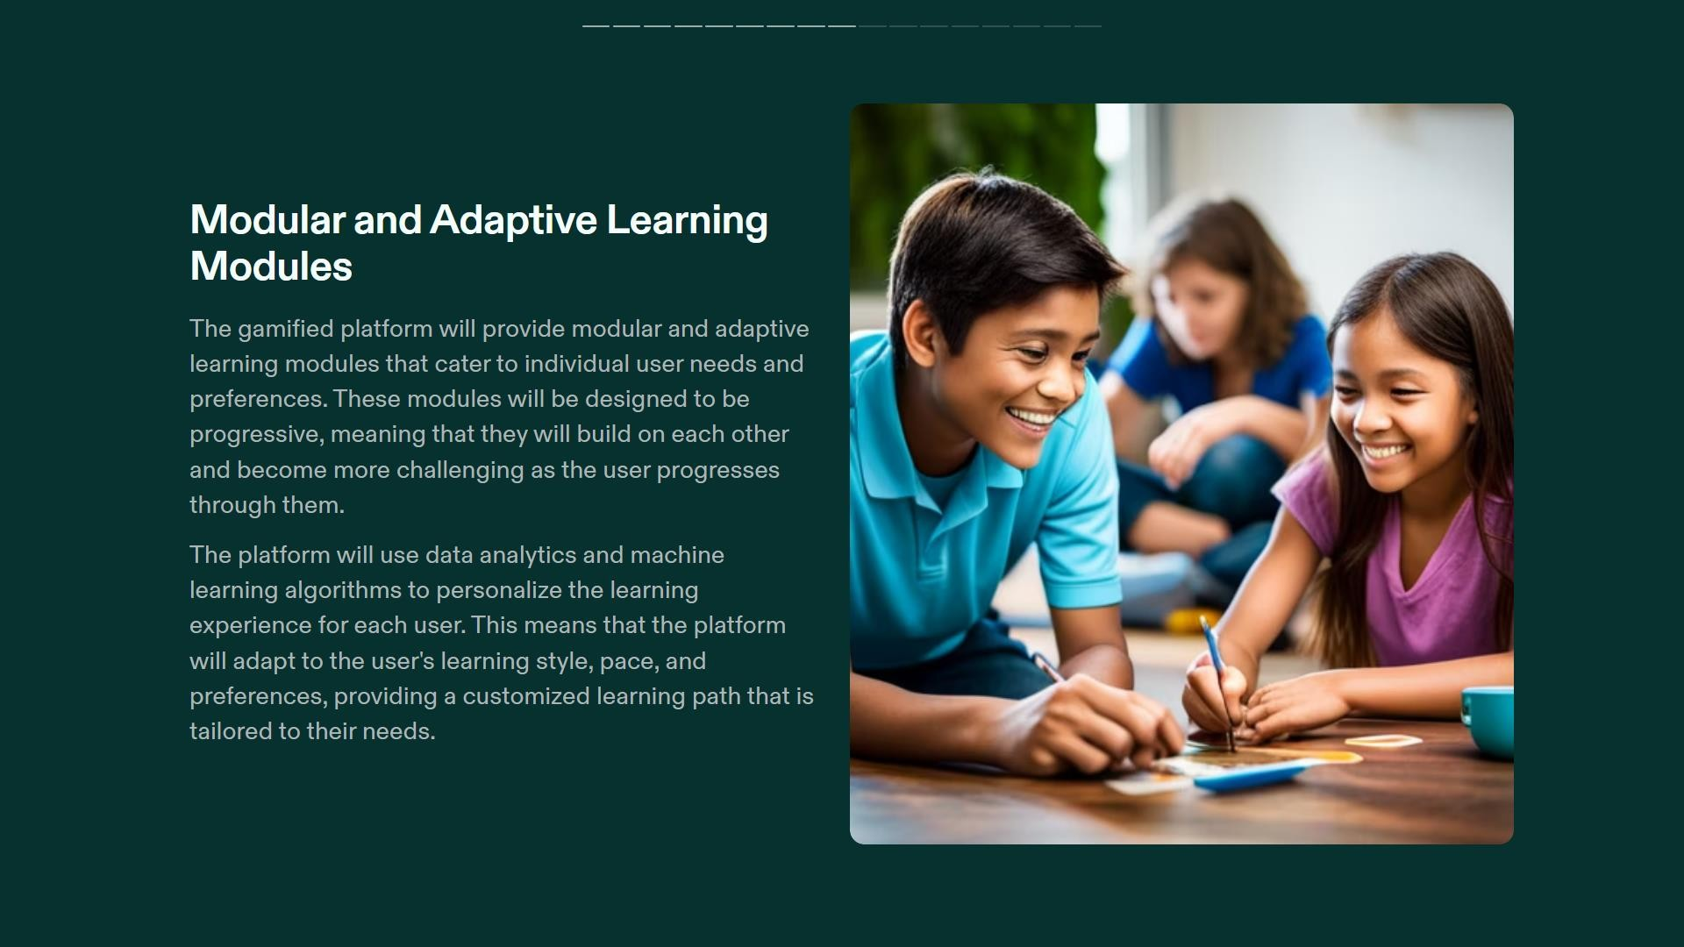

Slide 11


Slide 12


Slide 13


Slide 14

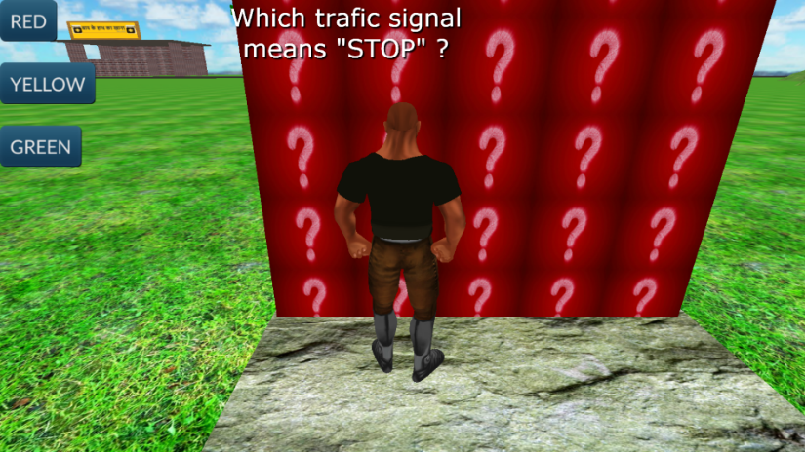
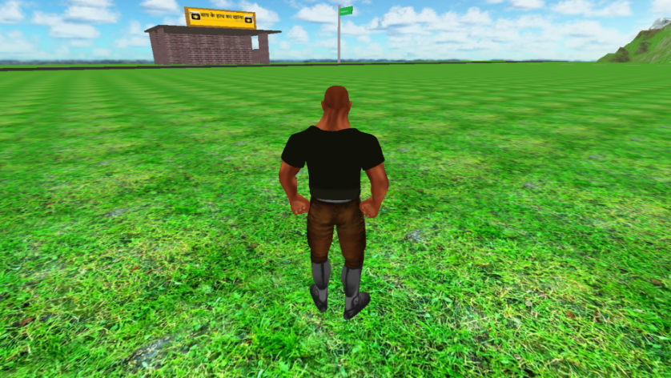
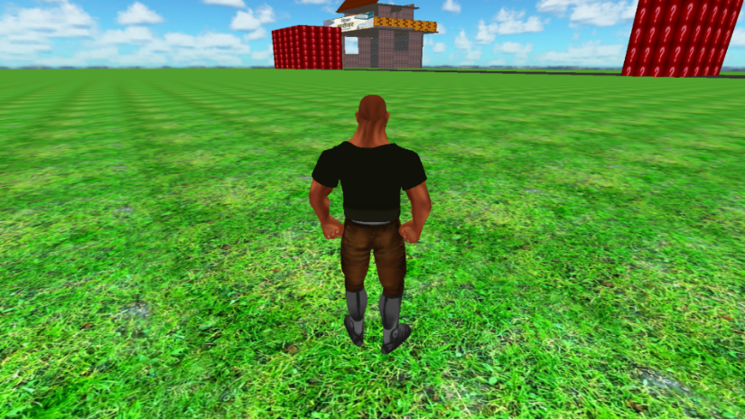
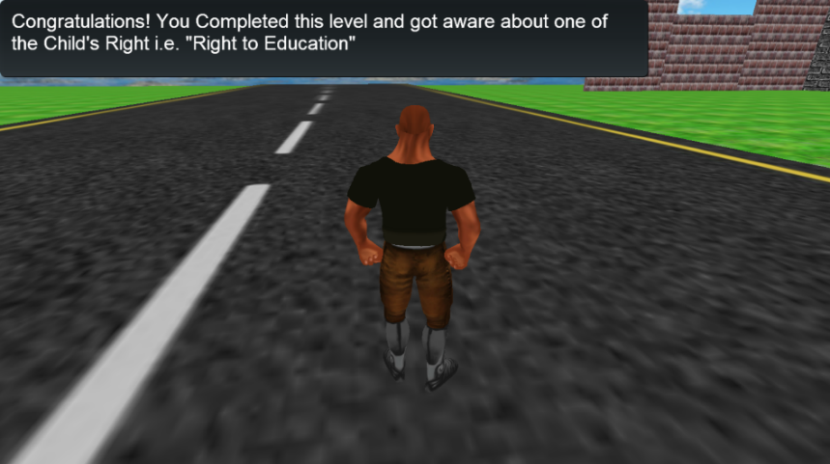
Prototype Game :
Scan me

Slide 15


